Slide 1
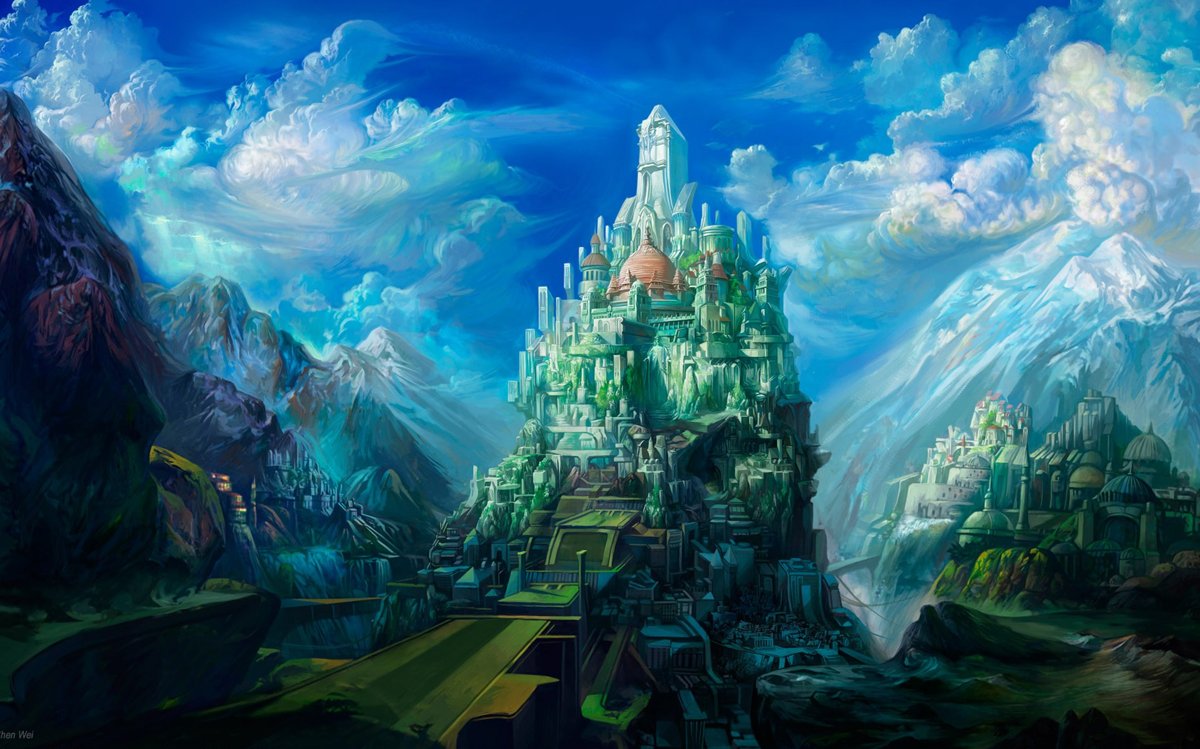
HEAVEN ON EARTH
SUNDAY

Slide 2
IT’S ALL ABOUT HEAVEN – AND YOU!

Slide 3
Just think of stepping on shore-
And finding it Heaven! Of touching a hand-
And finding it God's! Of breathing new air-
And finding it celestial! Of waking up in glory-
And finding it home!

Slide 4
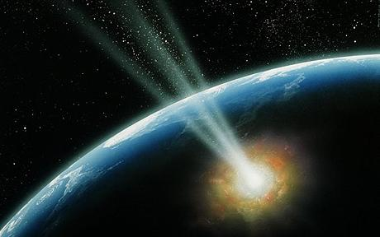
PARADISE LOST by John Milton 1557
PARADISE REGAINED (& RELOCATED)
TO “HEAVEN”!
Rev. 22:1-4 & 2:7

Slide 5
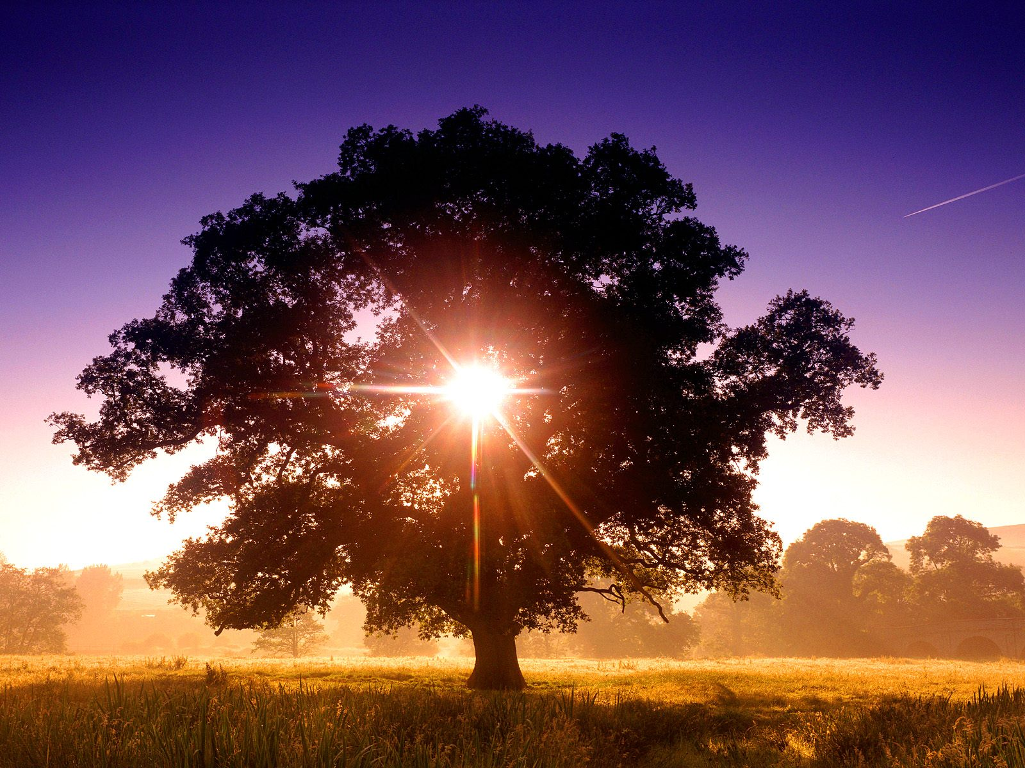
TREE OF LIFE
PARADISE

Slide 7
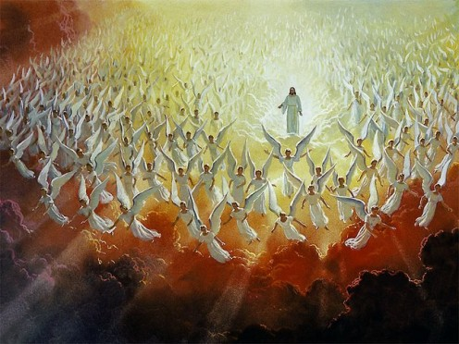
LESS LIKE THIS!

Slide 8
MORE LIKE THIS!

Slide 9
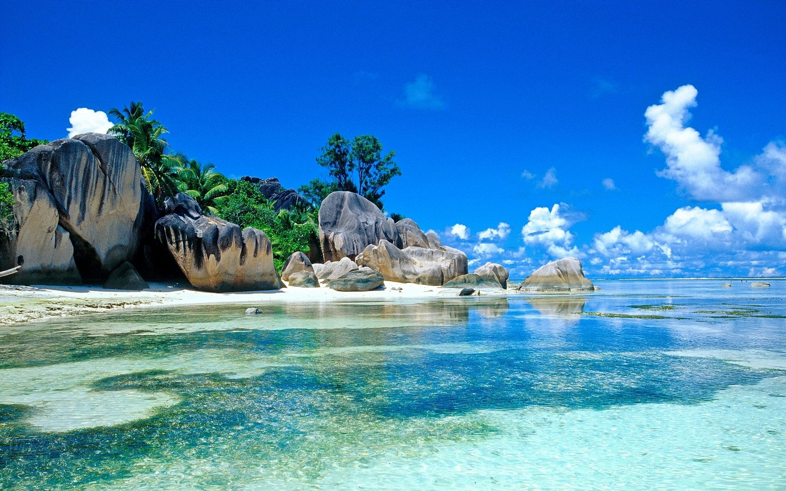
Eden was a real place with trees, animals and people.
Is the Eden in Paradise Regained in heaven less than the original or perhaps even better than the original?

Slide 10
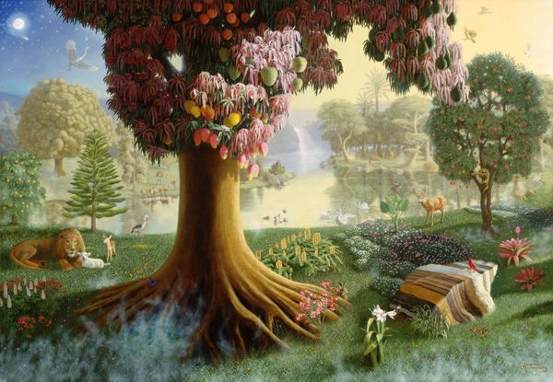
PARADISE REGAINED
Paradise has been relocated to “Heaven”.
Paradise was only lost to earth, but lives on in Heaven.

Slide 11
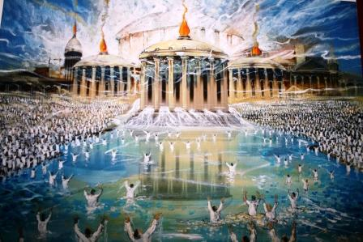
“And he shewed me a pure river of water of life, clear as crystal, proceeding out of the throne of God and of the Lamb…

Slide 12
“…in the midst of the street of it, and on the other side of the river, was there the TREE OF LIFE, which had twelve manner of fruits…” Rev. 22:1,2a

Slide 13
“He that hath an ear, let him hear what the Spirit saith unto the churches; To him that overcometh will I give to eat of the TREE OF LIFE which is in the midst of the Paradise of God.” Rev. 2:7

Slide 14
1. HEAVEN IS NOT THE OPPOSITE OF EARTH
Heaven is the Continuity of What Earth Was Designed To Be
Heaven is the Restoration of What Earth Was Designed to Be

Slide 15
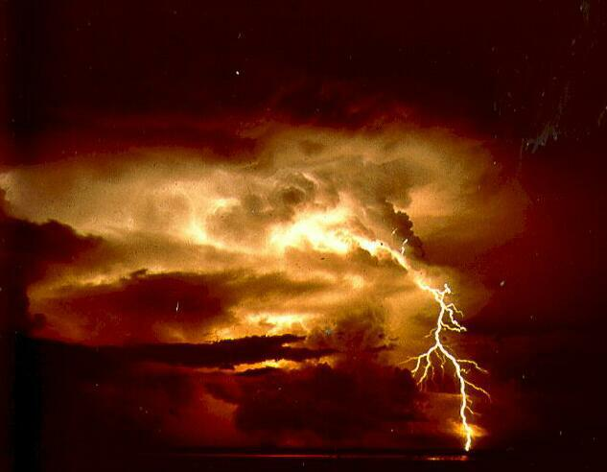
Because the creature itself also shall be delivered from the bondage of corruption into the glorious liberty of the children of God.

Slide 16
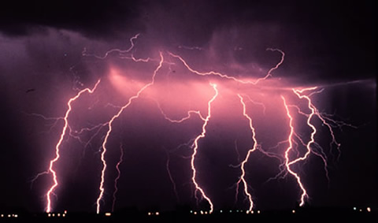
For we know that the whole creation groaneth and travaileth in pain together until now…

Slide 17
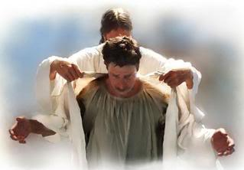
…and not only they, but ourselves also, which have the firstfruits of the Spirit, even we ourselves groan within ourselves, waiting for the adoption, to wit, the redemption of our body. Rom. 8:21-23

Slide 18
1. HEAVEN IS NOT THE OPPOSITE OF EARTH
Heaven is the Continuity of What Earth Was Designed To Be
Heaven is the Restoration of What Earth Was Designed to Be

Slide 19
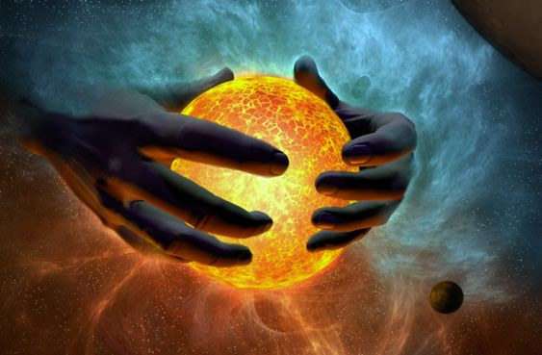
“Whom (Christ) the heaven must receive until the times of restitution of all things, which God hath spoken by the mouth of all His holy prophets since the world began.” Acts 3:21

Slide 20
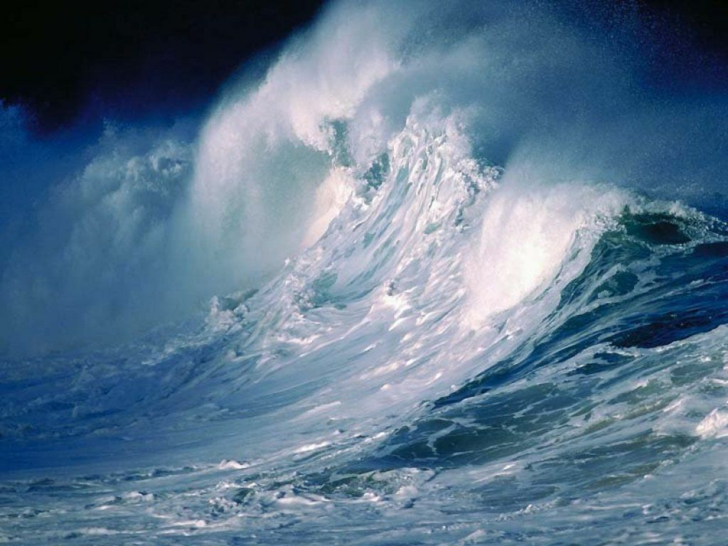
The original earth was destroyed (not eliminated) by water!

Slide 21
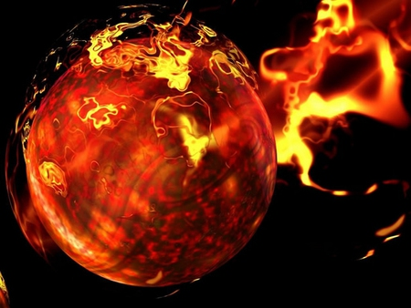
Our present earth will be destroyed (not eliminated) by fire

Slide 22
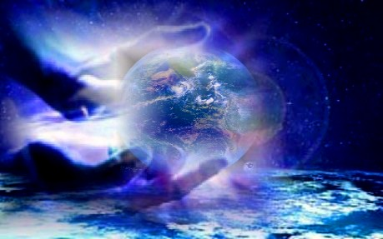
God will create a New Heaven & a New Earth

Slide 23
“first” = Gr. “prote” [prototype] i.e. (Pattern for the finished product!)

Slide 24
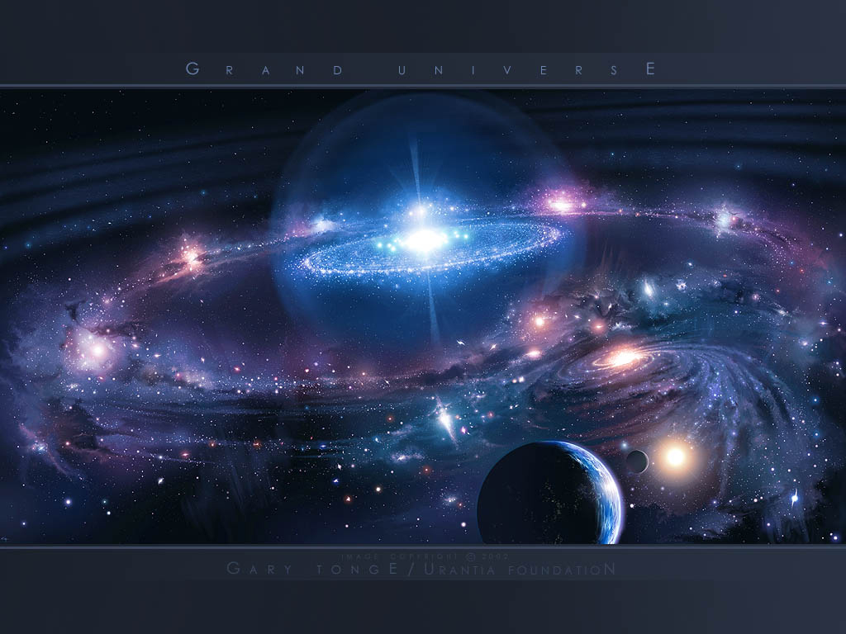
NEW HEAVEN &
NEW EARTH

Slide 25
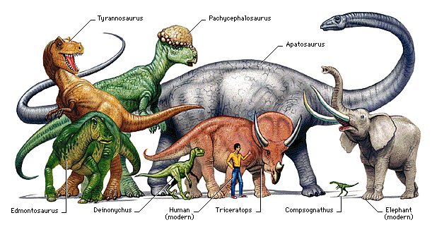
Scientists tell us that 90% of the animals originally on earth have become extinct!

Slide 26
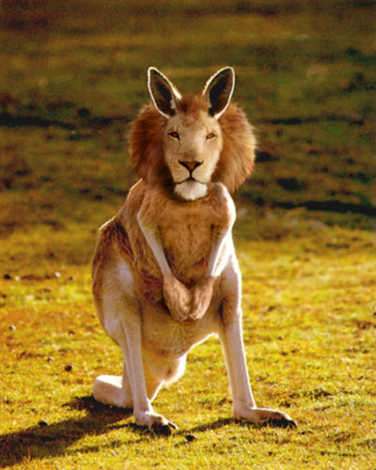
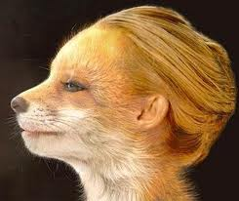
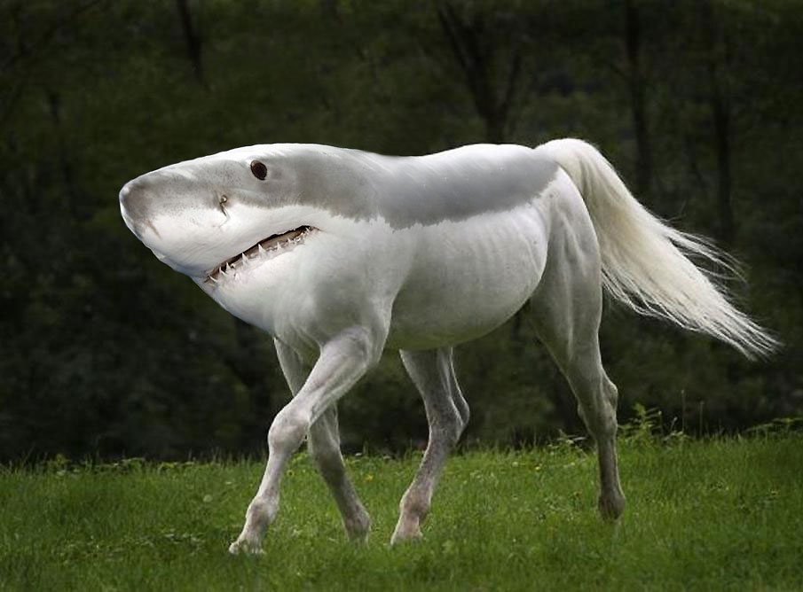

Slide 27
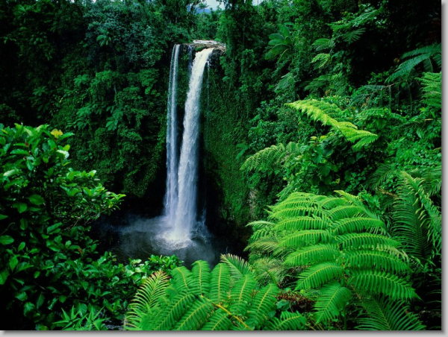
2. “HEAVEN” INCLUDES THE NEW EARTH
The New Earth Will Be God’s Dwelling Place
Wherever God dwells that is Heaven!

Slide 28
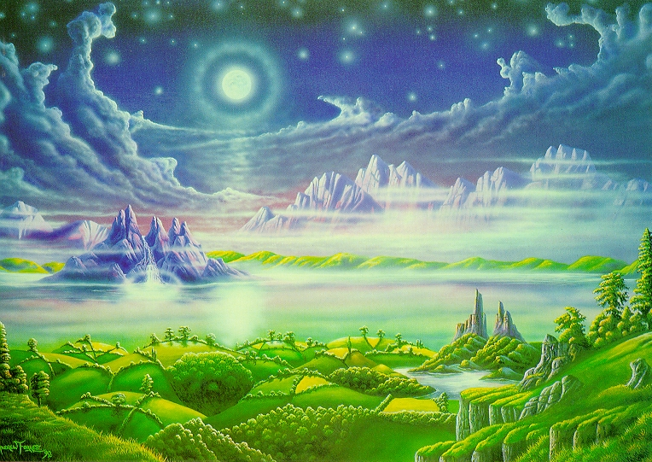
And I heard a great voice out of heaven saying, Behold, the tabernacle of God is with men, and He will dwell with them, and they shall be His people, and God Himself will be with them, and be their God. Rev. 21:3

Slide 29
2. “HEAVEN” INCLUDES THE NEW EARTH
The New Earth Will Be God’s Dwelling Place
The New Earth Will Be Our Dwelling Place

Slide 30
For I know that my Redeemer liveth, and that He shall stand at the latter day upon the earth…in my flesh shall I see God: Whom I shall see for myself, and mine eyes shall behold… Job. 19:25,26

Slide 31
2. “HEAVEN” INCLUDES THE NEW EARTH
The New Earth Will Be God’s Dwelling Place
The New Earth Will Be Our Dwelling Place

Slide 32
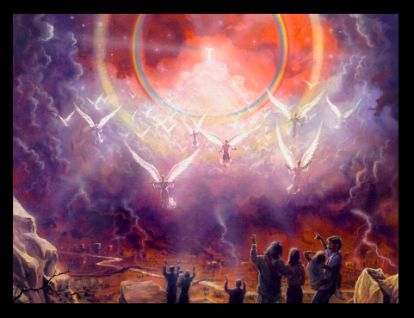
Beloved, now are we the sons of God, and it doth not yet appear what we shall be: but we know that when He shall appear, we shall be like Him; for we shall see Him as He is. 1 John 3:2

Slide 33
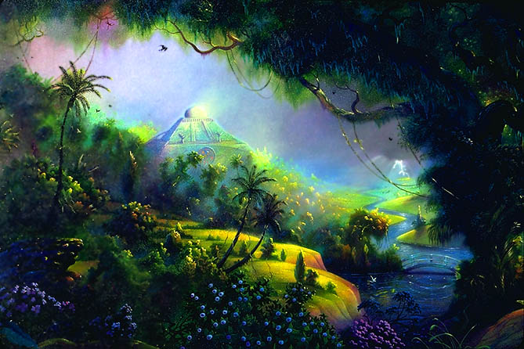
PARADISE REGAINED
Heaven is only the gift; He is the Giver.
Heaven is only the dwelling place, He purchased the ticket to that dwelling place.

Slide 34
PARADISE REGAINED
Is Heaven YOUR hope?
YOUR future home?

Slide 35
PARADISE REGAINED
Christian:
Are you prepared to make your move to Heaven?!

Slide 36
PARADISE REGAINED
Unsaved Friend:
Are you going to Heaven?! Not unless you receive Christ, the One Who paid your way to Heaven!

